Slide 1



23PCCE501L – Artificial Intelligence and Machine Learning Laboratory
TY BTECH COMP DIV A
Group 4
Transaction Fraud Detection Using Machine Learning Techniques
UCE2023453 : Janhavi Patki
UCE2023471 : Shriya Tijare
UCE2023473 : Esha Vasagadekar

Slide 2



01
Introduction
Financial transactions have increased massively through online banking, UPI, e-commerce, wallets, etc.
Along with this growth, fraudulent transactions have also increased.
Manual rule-based systems often fail to detect evolving fraud patterns.
Machine Learning helps identify fraud by learning patterns from historical data.
This project uses Logistic Regression & Random Forest models to classify transactions as fraud or normal
Our project adds an extra layer of intelligence: Location-based behavior analysis.

Slide 3
02
Objective
Build a reliable ML system to detect fraudulent transactions.
Train and compare Logistic Regression & Random Forest on a real transactions dataset.
Preprocess data: scaling, handling imbalance, stratified split.
Evaluate using Accuracy, Precision, Recall, F1-score, ROC-AUC.
Build a Gradio-based user interface to test fraud risk in real-time.
Analyze model behavior, outcomes, and challenges.
Integrate user location + transaction location similarity

Slide 4
03
Problem Statement
To develop an efficient and scalable machine learning model capable of detecting fraudulent financial transactions using supervised learning techniques and deploy it with an interactive interface.
Challenges Addressed:
Real-time decision requirements
Evolving fraud patterns
Need for accurate + interpretable predictions
Existing datasets do not contain location information, limiting fraud analysis.
Need a system that combines transaction patterns + location behavior.

Slide 5
04
Market Analysis
Digital payments in India grew over 50% yearly due to UPI and online banking.
Fraud cases such as phishing, unauthorized transactions, OTP theft, and merchant scams are rising.
RBI reports growing financial cybercrime cases every year.
Businesses require:
Real-time fraud detection
Explainability
Scalability
High fraud recall (avoid missed frauds)

Slide 6
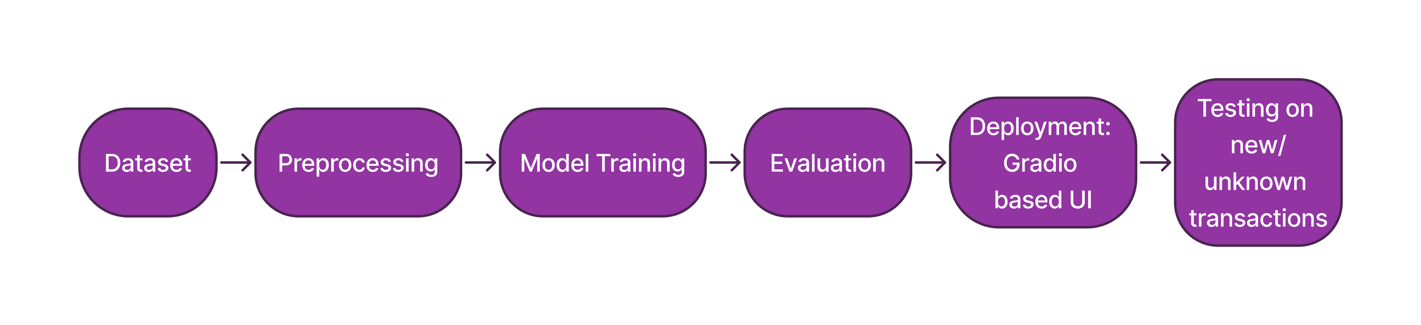
05
Methodology

Slide 7
06
Outcomes
Models trained successfully on anonymized transaction dataset
Random Forest performed best in terms of recall & AUC
Generated Confusion Matrix, ROC Curve, Accuracy Table
Created a working Gradio app for predicting fraud probability
Created a donut chart showing contribution of the features

Slide 8
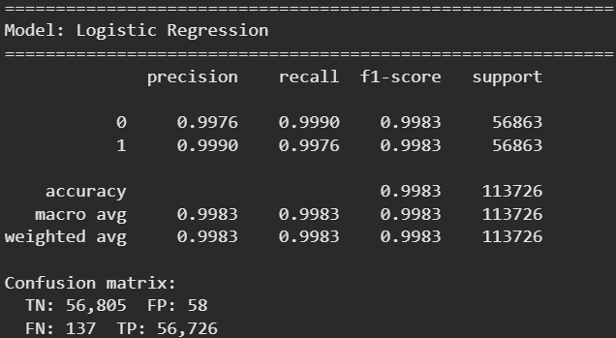
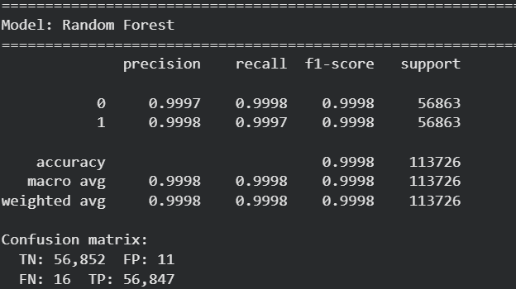
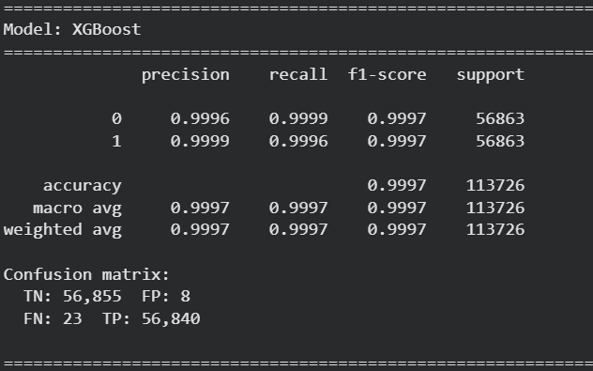
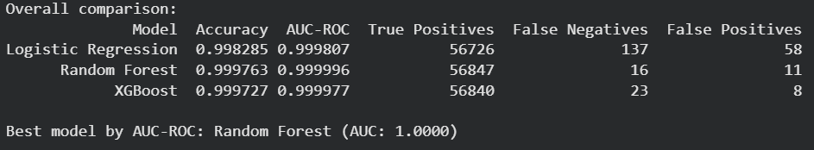
07
Results

Slide 9
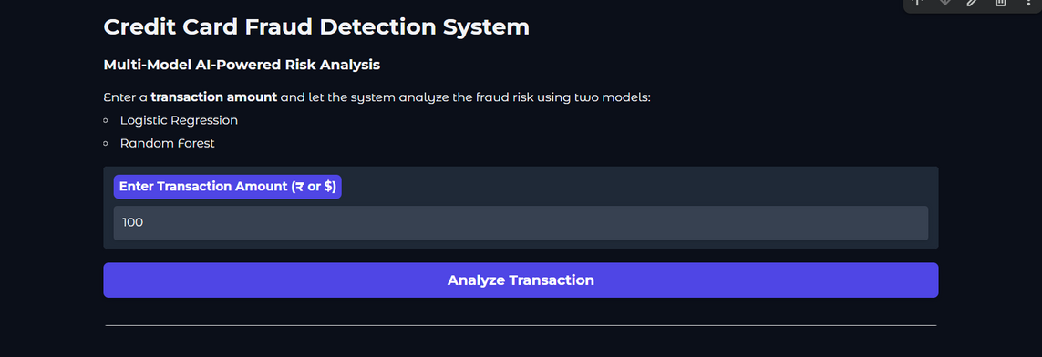
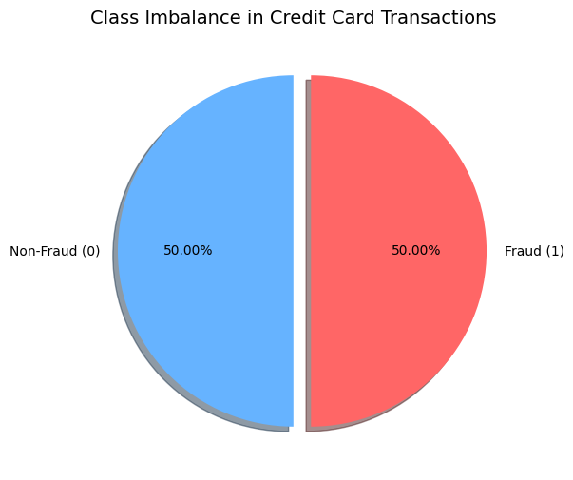
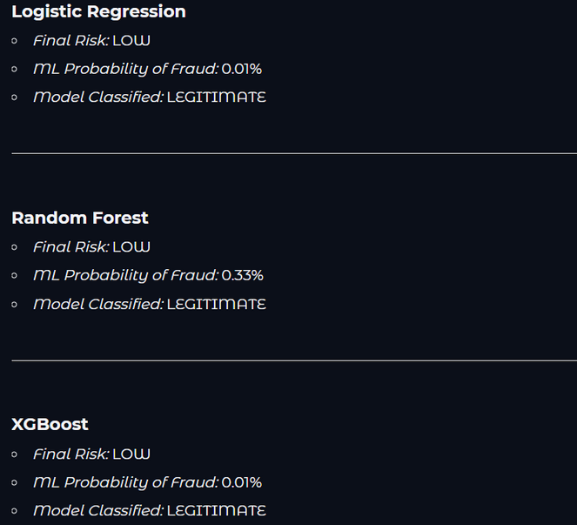
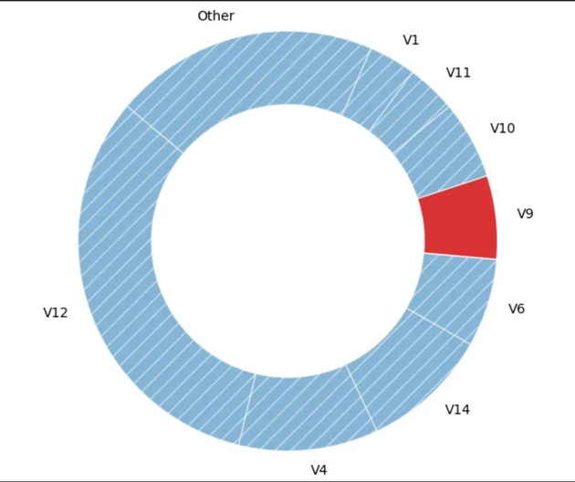
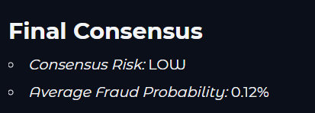
Reason of Results

Slide 10
08
Conclusion
Developed an end-to-end Transaction Fraud Detection system.
Compared LR and RF and XGBoost .
Achieved extremely high accuracy due to clean anonymized dataset.
Demonstrated real-time prediction using Gradio.
System can be extended for banks, wallets, e-commerce, and merchant fraud protection.

Slide 11

09
Future Scope
Add SHAP explain-ability
Deploy model as API or web service
Integrate deep learning or anomaly detection
Add real-time streaming data
User behavior profiling
Adaptive retraining pipeline

Slide 12
10
Acknowledgement
We sincerely thank:
Our project guide :
Varsha Pimprale
Dr. Sandhya Arora
Open-source contributors of datasets/tools
Kaggle for providing dataset access
References
Gradio documentation
Kaggle: Fraud Transaction Dataset
West, Bhattacharya. “Intelligent financial fraud detection”

Slide 13
Thank You

